Slide 1

Belgian Science Policy Office (BELSPO)
Open Access policy and its federal context
Eric Laureys
10-02-2016

Slide 2
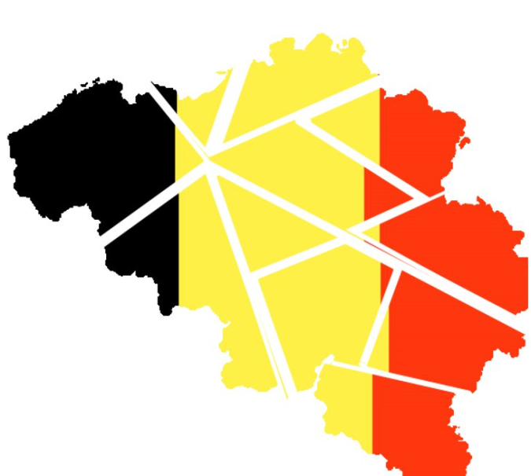
Institutional Belgium
Competences over fundamental research:
Communities : Education (Universities)
Federal Adm. : Fields defined by national interest and international commitments (BELSPO, Research Institutions)

Slide 3
BELSPO Open Access mandate
General approach :
- Enforcing Green OA
- Fostering Fair Gold OA
Policy rationale :
- Making society benefit from taxpayer funded activity
- Support the sustainability and the development of scientific research
- Honor public responsibility with regard to long term national heritage conservation

Slide 4
BELSPO Open Access mandate
Common Green OA requirements :
- Mandatory ID/OA with retention of needed rights
- Grey literature
- 6/12 month embargoes
- Choice of OAI-PMH compatible repository
- CC BY for articles, CC BY-NC for monographs
Uncommon Green OA requirements :
- Immediate deposit of BELSPO project reports (mandate includes report editing instructions)
- Immediate OA for articles published before 1993
- Negotiated monograph embargo allowed but embargo duration has to be established

Slide 5

BELSPO mandate credibility
Backing of Green OA mandate with real infrastructure :
- Centralised for 14 research institutions
- Repository administration entrusted to Royal Library
- Considering merger with Legal Depot’s digital extension
- Soon to be opened up to other federal departments

Slide 6
BELSPO Open Access mandate
Common Gold OA requirements :
- Journal listed with recognised on line directories
- Transparency for publishers, venues and APC
- No hybrid unless proven absence of Double Dipping
- No bundled APC deals at a fixed sum per timeframe
- No differential charges for Creative Commons
Uncommon Gold OA requirements :
- Hybrid allowed for monographs
- Grant based APC cap of €1300 + 20% of outstanding sum
- For monographs : €6000 + 20% of the outstanding sum

Slide 7
BELSPO Open Access mandate
Furthering compliance:
- Evaluation based solely on repository bibliography
- In cases of noncompliance with APC, embargo, protection, licence and copyright policies, concerned publications will be withdrawn from bibliography
- Full text accessibility provides edge with evaluation
- Exceptions may be granted by a special OA Commission

Slide 8
BELSPO OA mandate acceptance
Reservation w.r.t. Green OA :
- Fear that OA will undermine book sales
- Fear of coercing senior researchers into complying
- Faith to existing institutional Integrated Library Systems
- Refusal of double import
Reservation w.r.t. Gold OA :
- Refusal of APC caps to maintain full IF potential
- Refusal to dump hybrid journals to maintain full IF potential
- Request funds for non-project based institutional research

Slide 9

Eric Laureys
Science Policy Officer
Scientific and Technical Information Service (STIS)
Belgian Federal Science Policy Office (BELSPO)
231 Avenue Louise
BE-1050 Bruxelles
+32 (0)2 238 37 51
www.stis.belspo.be
eric.laureys@stis.belspo.be

